Slide 1
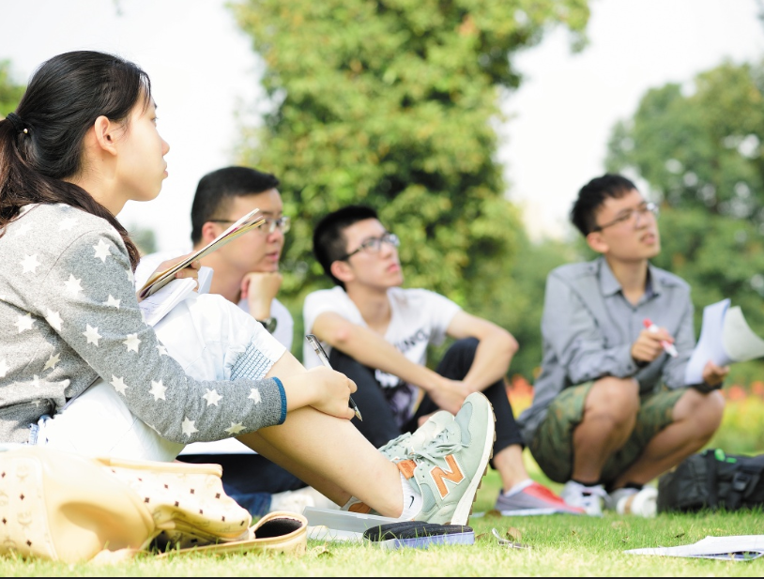

Oral Communication Skills B
(CELEN082)
Lesson 9.1

Slide 2
Lesson aims and objectives
Increase awareness of three key principles of using body language. Practise using body language to enhance ability to express a message to an audience. Increase awareness of methods of preparing for presentations. Practise writing effective presentation notecards.

Slide 3

Getting started

Slide 4

Getting started
For homework you were asked to watch a video about body language for presentations.
Using the notes you took, decide whether the statements below are TRUE or FALSE.
According to Alex Lyon, a communication coach, presenters should … |  | T / F
1 | look at the audience when they’re speaking, not at their slides.
2 | try to look at as many people as possible when they’re speaking.
3 | try to show they’re professional by not smiling.
4 | not walk around during a presentation.
5 | stand with their feet shoulder-width apart.
6 | stand with more weight on the front of their feet.
7 | keep their hands at the side of their body.
8 | nod their head slightly when they pause after a key idea.
T
F
F
For our exam, you CANNOT walk too much as you will be video recorded!
F
T
T
F
T
The team that gets the lowest score in the quiz will act as the body language performers later.

Slide 5
Using body language

Slide 6
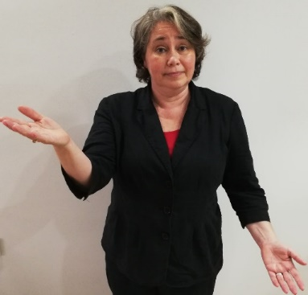
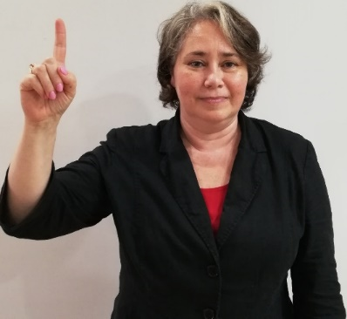
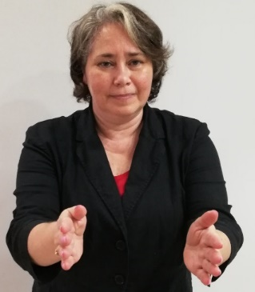
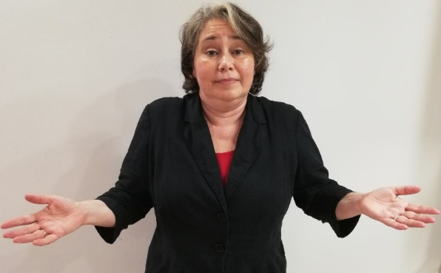
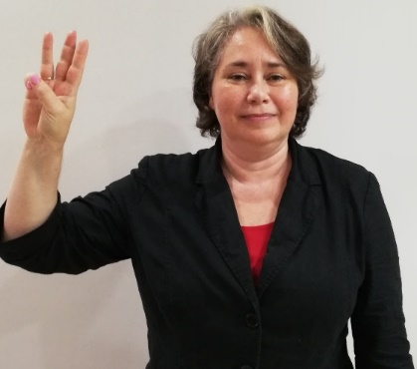
Using body language: Logical actions
One principle of body language is that you need to choose an action that logically matches what you’re saying.
A
Match the sentences below to the corresponding photos.
 | Sentence | Photo
1 | I think there are three main issues here.
2 | On the one hand … on the other hand …
3 | I would like to focus on this in particular.
4 | Let’s just remember one thing.
5 | So, what can we do about it?
B
C
D
E

Slide 7
Using body language: Logical actions
A
B
C
(2)
On the one hand … on the other hand …
(4)
Let’s just remember one thing.
(3)
I would like to focus on this in particular.

Slide 8
Using body language: Logical actions
D
E
(5)
So, what can we do about it?
(1)
I think there are three main issues here.

Slide 9

Using body language: Timing
A second principle of body language is that you use it at an appropriate time. Body language is often timed to a trigger word.
In your group, complete the tasks below:
Underline the trigger words in the sentences from the previous activity.
Stand up.
Practise saying the sentences and performing the body language.
(Hint: the trigger word is often stressed)

Slide 10
Using body language: Timing
A
B
C
(2)
On the one hand … on the other hand …
(4)
Let’s just remember one thing.
(3)
I would like to focus on this in particular.

Slide 11
Using body language: Timing
D
E
(5)
So, what can we do about it?
(1)
I think there are three main issues here.

Slide 12
Using body language: Be natural
A third principle of body language is that, while it should be used, you don’t have to use particular features that make you feel uncomfortable - it should feel natural!
In your group, complete the tasks below:
Tick any body language from the Getting started activity and/or the five photos that might make you feel uncomfortable.
Compare your answers with your group and discuss actions that feel natural and any that feel unnatural.
In the Final Presentation, you will be assessed on the effectiveness of your body language (i.e. eye-contact, gestures).

Slide 13
Using body language: Practice
Analyse the sentences on the next slide and complete the following tasks:
For each sentence underline the word(s) that could trigger a gesture.
Practise saying each sentence with appropriate gestures.
You may have to perform your sentence for the class.

Slide 14
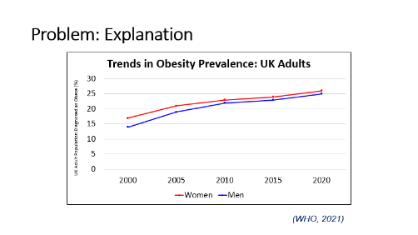
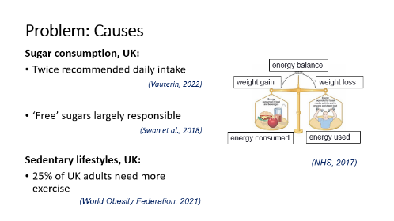
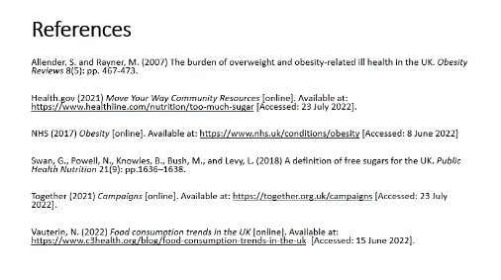
My presentation will focus on obesity in the UK and will be divided into two parts.
Over the last twenty years, obesity in the UK has become a huge problem.
On the one hand, it’s a very effective solution. But on the other hand, it’s expensive.
But this isn’t just about me. It’s about you, every one of you here today.
So, what’s the long-term impact? Frankly, who knows?
And the first solution I’d like to discuss is banning the advertising of sugary drinks.
I propose that we expand our product range by 25%.
This line graph shows trends in obesity among UK adults between 2000 and 2020.*
The fundamental cause of obesity is an imbalance between calories consumed and calories expended.**
The cost has gone up from six to eight million dollars.
We’d need to create the resources, build a website and publicise the campaign.
And it’s powered by the tiniest microchip you’ve ever seen.
What we need to do is work, work and work again.
Have you eaten junk food this week? Raise your hand if your answer is ‘yes’.
It’s not only our responsibility to do this, the public need to be involved too.
Thank you for listening. Here’s my reference list.***

Slide 15
Using body language: Practice
Your tutor will ask each of you to come to the front of the class and perform one of the sentences.
Give each presenter a score for their body language! Write the student’s name next to their sentence and give them a score (1-5).
Like a tree (too little body language) |  |  | Confident and expressive |  |  | Like a bad movie star (too much body language)
1 | 2 | 3 | 4 | 5 | 4 | 3 | 2 | 1
*The images for Sentences H, I and P are on the next three slides.

Slide 16
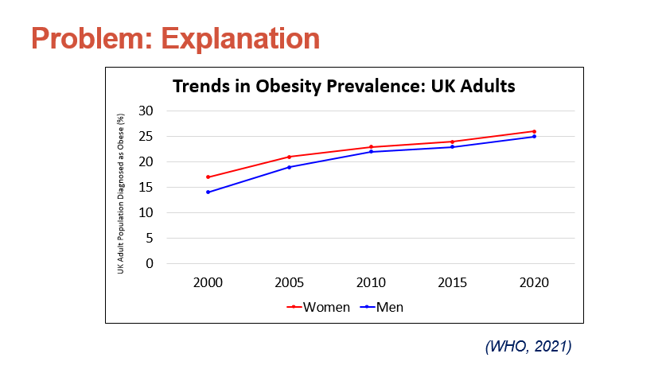
Using body language: Sentence H

Slide 17
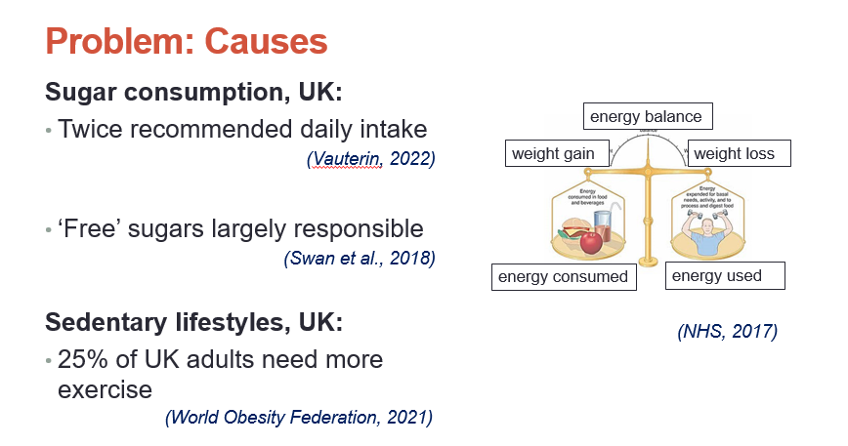
Using body language: Sentence I

Slide 18
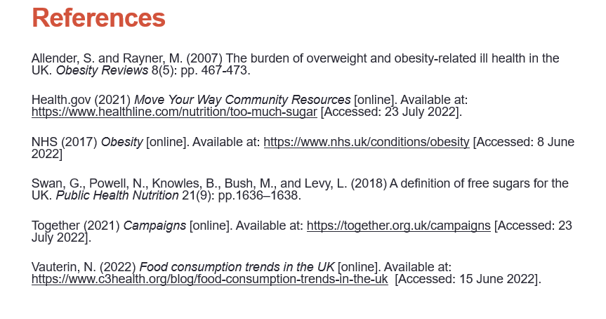
Using body language: Sentence P

Slide 19
Using body language: Practice
Compare your scores with your group and decide which student is the most effective body language user.
Like a tree (too little body language) |  |  | Confident and expressive |  |  | Like a bad movie star (too much body language)
1 | 2 | 3 | 4 | 5 | 4 | 3 | 2 | 1

Slide 20
Presentation
delivery methods

Slide 21



Presentation delivery methods
Experienced speakers may use a range of approaches to deliver a presentation. In your group, decide what are the advantages and disadvantages of each delivery method below.
memorising a script
using notecards
using your PPT slides to guide you

Slide 22
Presentation delivery methods: Using your PPT slides
using your PPT slides to guide you
Advantages
This method can make your performance look natural.
You can use your body to highlight information on the slides.
Disadvantages
You have to remember to face the audience.
You may forget details that are not included on the slide.
Identify at least one solution to these disadvantages.
Solutions
Practise delivering your presentation several times and ask a friend to act as your ‘audience’. Remember to look at them.
Practise your presentation as many times as you need to remember what you want to say. Draft a script to help you.

Slide 23
Presentation delivery methods: Memorising a script
memorising a script
Advantages
This method may improve your language accuracy.
This method can aid your natural delivery. You can:
break your script into natural chunks.
highlight words to stress.
mark intonation patterns.
Disadvantages
This method may interfere with eye contact. People often look upwards when speaking from memory.
This method may interfere with your natural delivery. You may forget to use pauses, stress and intonation. You may sound like a robot.
During presentations, people get stressed. Their memory may go blank.
Identify at least one solution to these disadvantages.

Slide 24
Presentation delivery methods: Memorising a script
memorising a script
Solutions
Practise delivering your presentation with your PPT several times. Video record yourself - focus on your use of eye contact when you watch the recording.
Mark pronunciation features on your script as we did in Lessons 2.1, 3.1 and 4.1. Practise delivering your presentation with these features. Record yourself.
Make notecards that contain the main points. Practise presenting using these cards.
Disadvantages
This method may interfere with eye contact. People often look upwards when speaking from memory.
This method may interfere with your natural delivery. You may forget to use pauses, stress and intonation. You may sound like a robot.
During presentations, people get stressed. Their memory may go blank.

Slide 25
Presentation delivery methods: Using notecards
using notecards
Advantages
Notecards can be a useful guide to the things you want to say that are not included on the slides.
This method can help your performance look natural and it is acceptable to use notecards when presenting.
Disadvantages
This method may lead to overreliance on your notecards.
If the notes on your cards are not well organised, they may be confusing.
If you drop them, you may not remember the order.

Slide 26
Preparing for a presentation : Using notecards
Using the piece of paper that your tutor gives you, write a notecard for the slide below, based on the information from the script.
Consider:
the types of information to include.
the level of detail to include.
And, in the UK over the last 20 years, [obesity] has become increasingly prevalent. Let me show you some statistics demonstrating this. This line graph, from the WHO, shows trends in obesity among adults in Britain between 2000 and 2020. The vertical axis represents the percentage of the UK adult population diagnosed as being obese and the two lines represent gender. The red line represents women and the blue line represents men. You can see that, for both sexes, levels of obesity have increased by around 10% over the past twenty years. The result of this increase is that, now, approximately one quarter of the UK population is obese which, I think you’ll agree, is a significant problem.
Compare your notecard with your group. Decide whose is the best and give at least one reason for your decision.

Slide 27

Preparing for a presentation : Notecard analysis
Compare the notecard of an experienced presenter to the one you created and identify the similarities and differences in terms of content and organisation.
__________________________________________________________________________________________________________________________________ ______________________ _______________________________________________________________________________________________________________________________________________________
OBESITY= PREVALENT
1
- WHO
- (2000 - 2020)
Face the audience
Eye contact
- gender
Red = women
Blue = men
- both sexes → increase cca.10% (20 years)
= ¼ UK pop. - obese

Slide 28
Preparing for a presentation : Notecard analysis
Cues for what to say (in note form)
__________________________________________________________________________________________________________________________________ ______________________ _______________________________________________________________________________________________________________________________________________________
OBESITY= PREVALENT
1
Number showing order of cards
(in case you drop them)
- WHO
- (2000 - 2020)
Face the audience
Reminders about delivery
Eye contact
- gender
Body language cues
Red = women
Cues for stressed words
Blue = men
This level of detail is acceptable for the Final Presentation. If you write full sentences or paragraphs on your notecards, you will NOT be allowed to use them.
- both sexes → increase cca.10% (20 years)
= ¼ UK pop. - obese
Please note that it is better to use notecards for your presentation NOT paper. Card is less ‘flappy’.

Slide 29
Presentation delivery methods
Experienced speakers tend to use a mixture of the methods below. The aim is to be as natural as possible.
memorising a script
using notecards
using your PPT slides to guide you
The approach you choose for your Final Presentation is up to you, but you are not allowed to read a script.

Slide 30
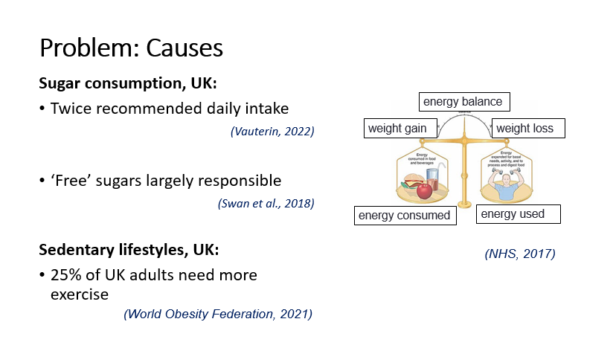
Using notecards: Practice
Based on what you have learned in today’s lesson, write a notecard for the slide/script below.
OK, so now, let’s take a look at the causes of this problem. The fundamental cause is an energy imbalance between calories consumed and calories expended. One of the major contributors to this is increased sugar content in the modern diet with a 2022 study by Vauterin estimating that sugar consumption in the UK has risen to twice the recommended daily intake. And this is largely due to ‘free’ sugar consumption. ‘Free’ sugars are sugars that are not naturally part of the food we eat. They’re simply added by food manufacturers to enhance taste. In addition to calories consumed, sedentary lifestyles exacerbate the situation. This is backed up by a 2021 study from the World Obesity Federation which shows that 25% of UK adults do not meet the recommended levels of physical activity, and this swells obesity rates.

Slide 31
Homework
Due | Task
Lesson 9.2 | This lesson is a LIVE LECTURE. Go to D.H. Lawrence Auditorium. Make sure you bring your OCSb Workbook.
Lesson 10.1 | You will receive the feedback on your PPT by Friday 18th April, 3pm. Review the feedback and make a list of questions you want to ask your OCSb tutor. In Lesson 10.1, you will have the opportunity to ask your questions. Bring your OCSb presentation PPT to class. Using the CELE Citation and Referencing Guide, write the references for three of the sources you will use for your Final Presentation. Post them on your class Team.

